Slide 1
3 Ideas Workshop
6.S198 Fall 2018
Monday, 9/24
Marwa Abdulhai
Notes:
https://goo.gl/forms/8FjsRbpJR25962vv1

Slide 2
1.
Bridging the Gap between People

Slide 3
Sign Language Interpreter
Goal: Create a system that will convert video feed of a person signing in American Sign Language into text to encourage communication between those who have no other way of expressing their ideas other than signing and a person who cannot sign
Why American Sign Language?
The natural language of around 500,000 deaf people in the US and Canada is American Sign Language (ASL)
A recent estimate claims that around 13 million people have some level of proficiency in sign language - ASL is the third most commonly used language in the US

Slide 4

Why am I interested in pursuing this idea?
Interested in using the potential of deep learning to cause a social impact and work on applications in the sphere of accessibility
Hope to explore technical problem of how to extract data from videos

Slide 5
Timeline of Project
Finding Data
American Sign Language Lexicon Video Dataset (ASLLVD) : Videos of > 3,300 ASL signs in citation form, each produced by 1-6 native ASL signers
Using Amazon Turk to gather data?
Literature Review & TensorFlow Tutorials
Language Recognition Using 3D Convolutional Neural Networks
Video Based Approach to Translation ASL to Sentences
TensorFlow Tutorials
Building CNN:
Using Convolutional Neural Networks to process videos into text (does not have to be coherent sentences)
Other techniques: https://sites.google.com/site/autosignlan/home including PCA, K Nearest Neighbors

Slide 6
Extensions
Assemble text into sentences that make sense -- exploring NLP techniques
Use Google Alexa to play sentences via speaker or look into Speech Recognition:
https://medium.com/@ageitgey/machine-learning-is-fun-part-6-how-to-do-speech-recognition-with-deep-learning-28293c162f7a
Develop network that can do the reverse: convert words into a video of someone signing:
https://www.youtube.com/watch?v=ugSx6H6EGh4
http://citeseerx.ist.psu.edu/viewdoc/download?doi=10.1.1.838.3584&rep=rep1&type=pdf

Slide 7
US! The most common misconception about ASL is that it is a signed version of English. ASL is not English at all. ASL is a distinct language with it’s own syntax and grammar and has been developed over hundreds of years by deaf people as a means of communication. It is also just as capable as English or any other language of communicating abstract or complex ideas. ASL signs are generally used to convey ideas and concepts rather than actual words. One sign may represent many ideas, so facial expressions and body language are essential to convey the full meaning of the sign. There may be some lip movement, but speech is not used when signing. Just like in English, there are also basic sign language elements. One of the elements, Fingerspelling, is used primarily to indicate places and people. There are also sign language symbols that have been developed in order to “write” sign language. Word order is very flexible in ASL. For example, the sentence “I am hungry” may be signed as “I hungry I,” “I hungry,” or “Hungry I.” Articles (a, an, and the) are not signed. Different grammatical forms for nouns, adjectives, and adverbs are also not distinguished. For example, “hungry,” “hunger,” and “hungrily” are all signed the same. The meaning must be found in the context. Challenges
Dealing with Misconceptions
ASL is a distinct language with it’s own syntax and grammar. ASL signs used to convey ideas and concepts rather than actual words
Facial expressions and body language are essential to convey the full meaning of the sign.
Word order is flexible in ASL: ”I am hungry” can be signed as “I hungry” or “Hungry I”. Articles are not signed. Different grammatical forms for nouns, adjectives, and adverbs are also not distinguished
Need to speak with people who know ASL
Dealing with Video As Input – Have only handled image data previously. Previous methods have only work
Getting Data - Do I have enough or will I need to look for more via Amazon Turk?
Recognition of alphabet and letter images in ASL

Slide 8
2.
Creating Arabic Calligraphy

Slide 9
Why am I interested in pursuing this idea?
Lived in the Middle-East for a while – have appreciation for Arabic
Islamic Calligraphy is a huge part of my culture
Interested in GANs and their implementation

Slide 10
Generating Arabic Words
Open Source dataset (includes 2000 similar-text paragraph images and 2000 unique-text paragraph images and their extracted text line images) http://khatt.ideas2serve.net/Contactus.php
Following similar model of generating pictures of cats: https://github.com/simoninithomas/CatDCGAN
Can also refer to this article on doing similar process with Chinese calligraph using Conditional Adversarial Networks: https://kaonashi-tyc.github.io/2017/04/06/zi2zi.html

Slide 11
US! The most common misconception about ASL is that it is a signed version of English. ASL is not English at all. ASL is a distinct language with it’s own syntax and grammar and has been developed over hundreds of years by deaf people as a means of communication. It is also just as capable as English or any other language of communicating abstract or complex ideas. ASL signs are generally used to convey ideas and concepts rather than actual words. One sign may represent many ideas, so facial expressions and body language are essential to convey the full meaning of the sign. There may be some lip movement, but speech is not used when signing. Just like in English, there are also basic sign language elements. One of the elements, Fingerspelling, is used primarily to indicate places and people. There are also sign language symbols that have been developed in order to “write” sign language. Word order is very flexible in ASL. For example, the sentence “I am hungry” may be signed as “I hungry I,” “I hungry,” or “Hungry I.” Articles (a, an, and the) are not signed. Different grammatical forms for nouns, adjectives, and adverbs are also not distinguished. For example, “hungry,” “hunger,” and “hungrily” are all signed the same. The meaning must be found in the context. Challenges
Trying to find the appropriate dataset: Can Try to dataset by pooling images from Google Images: https://www.pyimagesearch.com/2017/12/04/how-to-create-a-deep-learning-dataset-using-google-images/
Knowing how much data may be needed to generate good results

Slide 12
3.
Connect 4

Slide 13
Why am I interested in pursuing this idea?
Interested in learning how to build GUI for the game
Interested in exploring Reinforcement Learning

Slide 14
Creating the Connect 4 Game
Goal: Explore Reinforcement Learning techniques to build a fun game for me to play!
https://blog.sicara.com/deep-q-learning-javascript-synaptic-convnet-connect-4-4dbdcd563d55

Slide 15
Resources
Reinforcement Learning: https://www.oreilly.com/ideas/reinforcement-learning-with-tensorflow
Connect 4 Rules: http://blog.gamesolver.org/solving-connect-four/01-introduction/

Slide 16
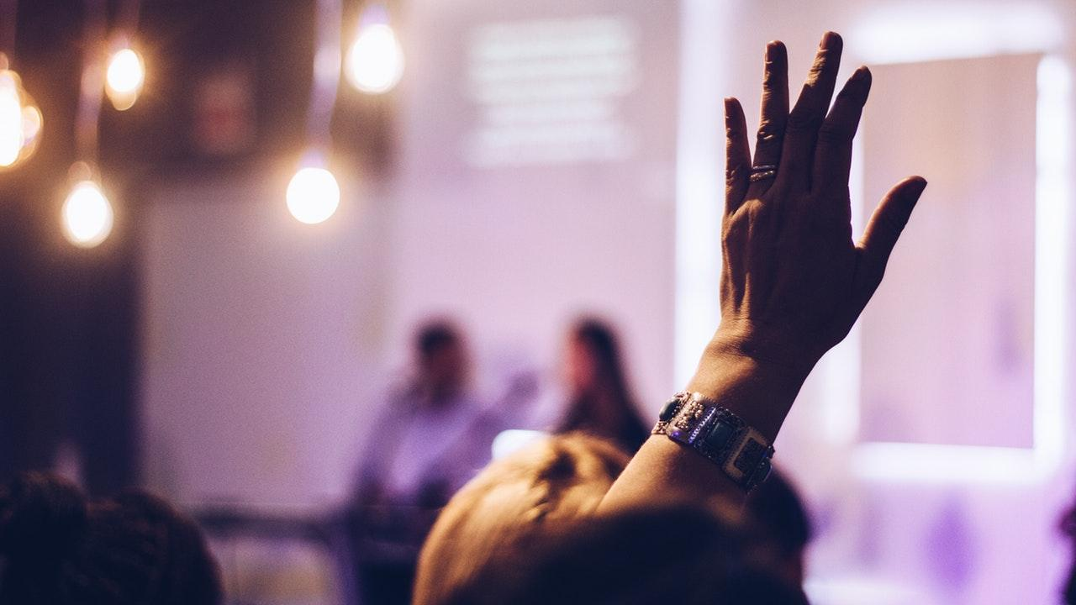
THANKS!
Any questions?

